Slide 1
PROJECT 1: EXPLORATORY DATA ANALYSIS OF MTA TURNSTILE
Enis Tokgöz – İlkay Gürsu – Hasan Enes Güray – Mehmet Hasan Alıcı

Slide 2



Project Flow
Problem/Need
Proposal/Resources
Data Analysis
Solution
Optimize the placement of street teams
Detection of solution proposals and obtaining necessary data
Cleaning and enriching the collected data
Presenting the most ideal solution proposal

Slide 3


Problem/Need
WomenTechWomenYes (WTWY) Society*, aims to reach as many people as possible for the gala they will organize in the summer term.
That's why they placed street teams collecting email addresses at the entrances of subway stations.
But their street teams are small and they don't have a chance to recruit more people.
Problem
How to optimize street crews at subway stations that collect email addresses to reach large numbers of people?
*WTWY society logo drawn as a representation.

Slide 4



Proposals/Resources
Find the most frequently used stations, to determine the most crowded day and time range from these stations.
Identifying stations close to these companies for access to technology-related company employees who are considered to have high e-mail usage, especially female employees with university education.
We will use the following data sources to provide a solution to this problem.
Analyzing MTA NYC subway data to identify busiest stations
March-May 2022 turnstile data, 14 .txt file
Identifying crowded stations close to technology companies with Google Maps
Start-ups, fintechs and other major technology companies.
Analysis of gender, education and income data by female citizens for New York City districts
Visualization of the obtained data according to female.

Slide 5






Data Analysis
We cleaned, organized and visualized the data using the following tools to propose a solution.
*March-May 2022 turnstile data, 14 .txt file
Exploratory
Data
Analysis
Tools

Slide 6
Retrieval of data
Data Analysis Process
Step 1
Data collection and formatting.
Merge, add and delete process.
Step 2
Creating Datetime, Day and Turnstile columns.
Check for NaN and duplicated data.
Step 3
Sorting data according to the asking columns.
Create a diff columns for acquiring the net traffic.
Step 4
Drop negative entry/exit values from dataset.
Step 5
Using groupby functions for gathering station data
Visualizations

Slide 7




Brief Data Insights
Dataset
Stations
Days
Hours
379 stations
5.049 turnstiles
34 ST – Penn Station most crowded
16.00-20.00
20.00-00.00
14 .txt file
2.739.787 rows, 11 columns
250,8 MB memory usage
Wednesday
Thursday
Friday
Most crowded days

Slide 8

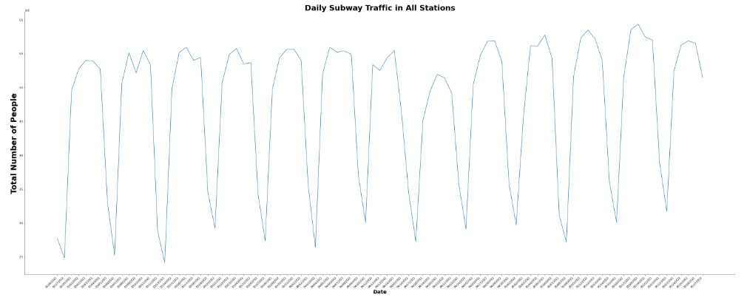
Station Insights
Graph of people using stations by date range
There is a decrease in the number of passengers on weekends.

Slide 9

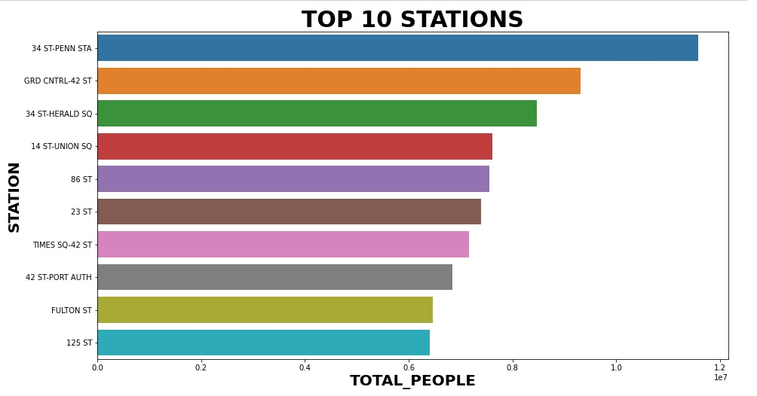
Most Used Station Insights
The top 10 most used stations according to the date we analyzed.
34 St – Penn Station is the most busiest station.

Slide 10
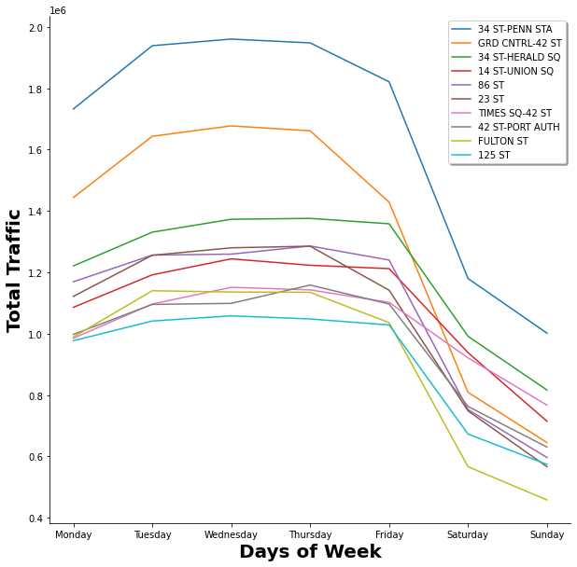




Total Traffic Insights
Total passenger traffic by day in the 10 most used stations according to the date we analyzed.
Looking at the graph, 34 ST Penn Station clearly seems to have the most passenger traffic.
In all stations, the number of passengers on weekends decreases compared to weekdays.
Some stations show serious passenger drops as if they were closed on weekends.
Fulton Street Station and 125 Street Stations have the least number of passengers on weekends.

Slide 11
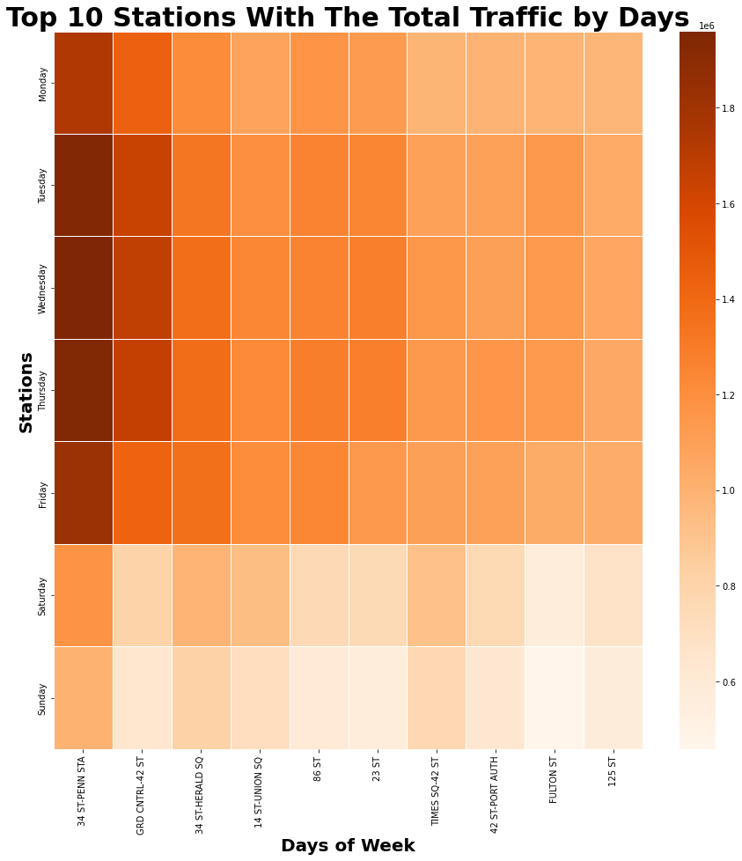


Total Traffic Insights
The total passenger traffic on a day-by-day basis at the 10 most used stations according to the date we analyzed is transferred to the heat map. Passenger traffic is indicated as maximum in dark color and minimum in light color.
Looking at the graph, 34 ST - Penn Station has a high passenger volume on Tuesday, Wednesday and Thursday.
At all stations, the number of passengers on weekends decreases compared to weekdays.
Most Busiest Station: 34 ST – Penn Station
Most Busiest Day: Wednesday
Most Crowded Time Slot: 20:00-00:00

Slide 12
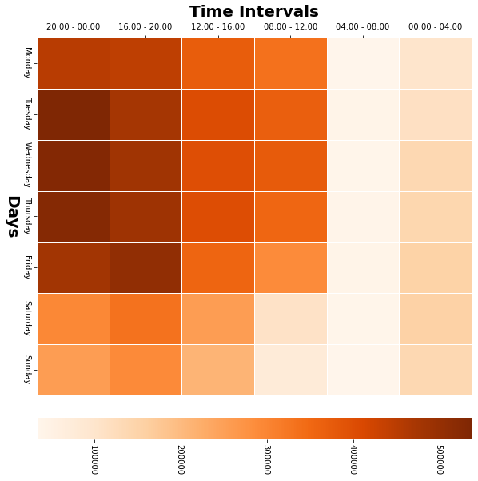

Solution Proposals
Let's re-examine the data we created as a result of the analysis.
Most crowded station: 34 ST – Penn Station
Busiest Day: Wednesday
Time Slot: 20.00-00.00
Weekday is more busy
Tuesday, Wednesday and Friday are most crowded days.
The day, time and station to be selected to reach the maximum number of people:
34 ST Penn Station, Friday, 16.00-20.00

Slide 13
Solution Proposals
Detection of crowded stations close to start-ups, fintechs and other big tech companies with Google Maps
New York is home to more than 9,000 startups, and that number is constantly growing. Most of these startups are located in the Manhattan area.
The busiest stations, which we marked on the map with the blue train logo, are also very close to these startups and fintechs.
5 of the 10 busiest stations we saw in our analysis are located in this region.
Especially, 34 St - Penn Station and 23 ST stations are very close to workplaces.
On the next page, you can see the map where we marked the business and metro stations.

Slide 14
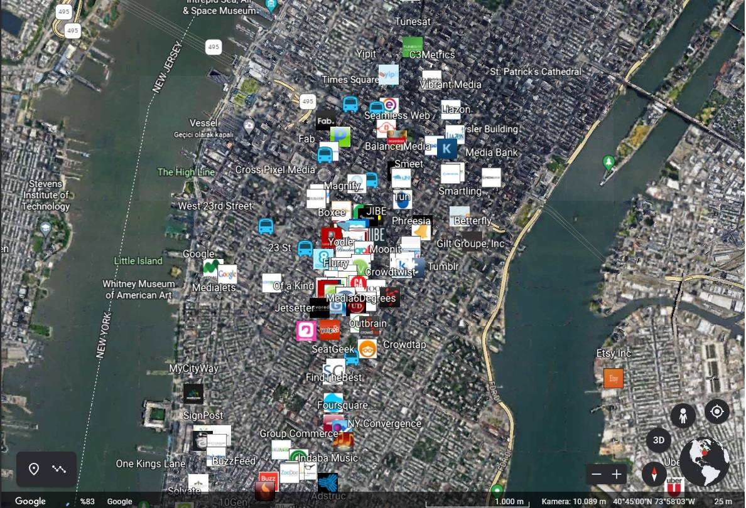
Solution Proposals

Slide 15
Advanced Proposals
The United States Census Bureau (USCB), officially the Bureau of the Census, is a principal agency of the U.S. Federal Statistical System, responsible for producing data about the American people and economy.
Short Brief About Census Data
The Bronx, Staten Island, Brooklyn, Manhattan, and Queens are the places we analyzed.
Brooklyn is NYC's most populous borough with a population of 2.5 million
1.3 million people live in Manhattan.
Although Brooklyn is the most populated borough, we will examine data for this area in our analysis , as the busiest stations are located in Manhattan borough.

Slide 16
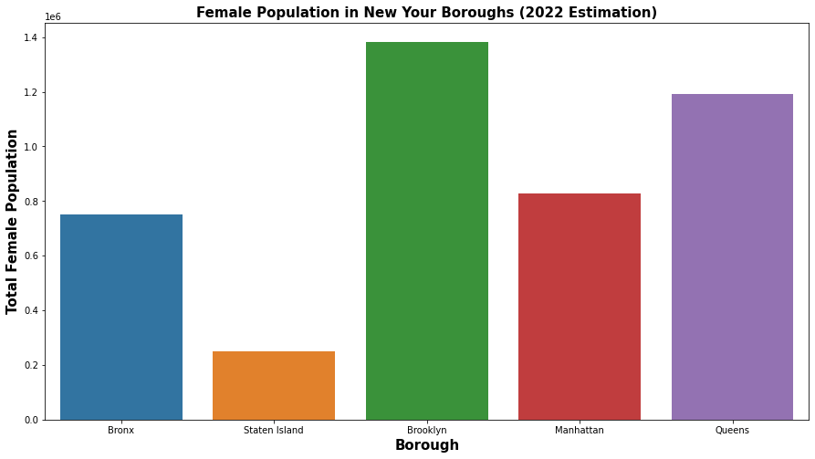
Advanced Proposals
1.3 million people live in Manhattan.
There are 807,536 women are living in the relatively Manhattan area

Slide 17
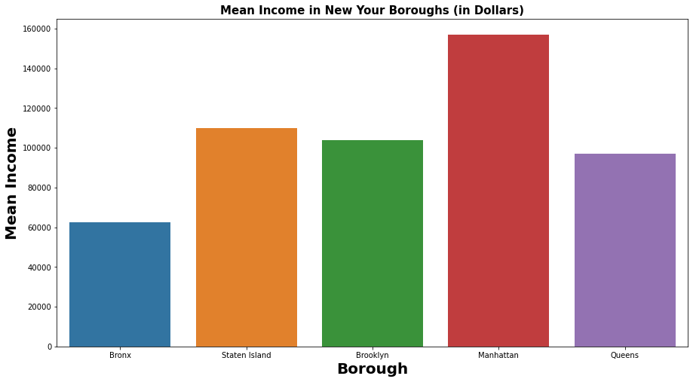
Advanced Proposals
Average female earnings $62,177, this average earning rise to the $155.000 in Manhattan borough.

Slide 18
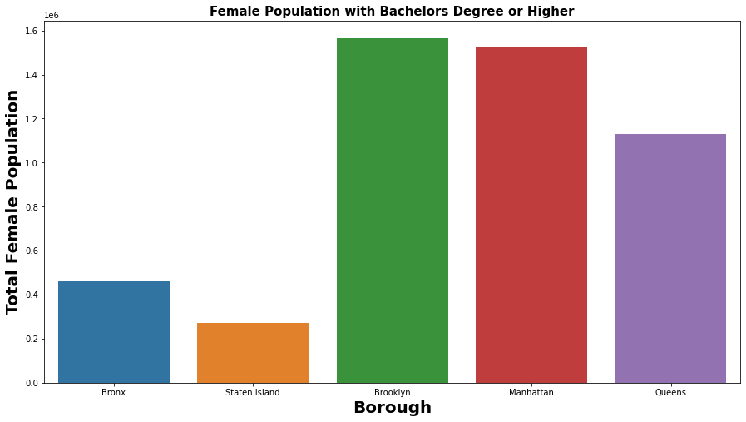
Advanced Proposals
Most educated women population are living in the Manhattan and Brookly borough.

Slide 19
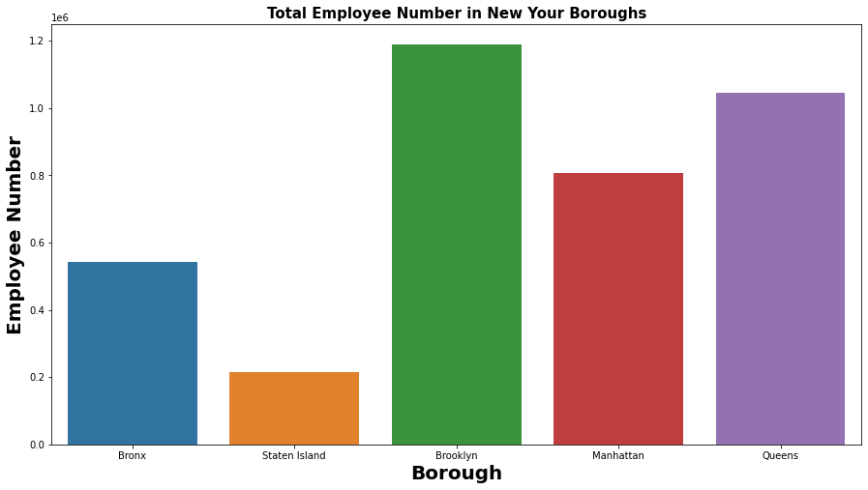
Advanced Proposals
Total number of female employees by borough.

Slide 20


Summary
The Manhattan borough, where the busiest stations are located, also stands out as the region with the highest income and the most educated female employees.
‘’For this reason, better results can be obtained if a large part of street crews are placed in 34 St - Penn Station, 42 ST and 23 ST stations in this area. ‘’
On the other hand, in order to see the potential, we can suggest that teams be placed in a few central stations in the Brookly region.

Slide 21

If we…
Had more time we could;
Analyze the NYC MTA data by separating it from tourist visits.
Examine location reporting data in cafes, restaurants and hotels around metro stations.
Check the usage hours of free wi-fi networks and the most used hotspots.

Slide 22

Finally

